Slide 1
Raul Alvarado
Impact
Wealth
Understanding
Discipline
Family
Love
Ambition
Health

Slide 2
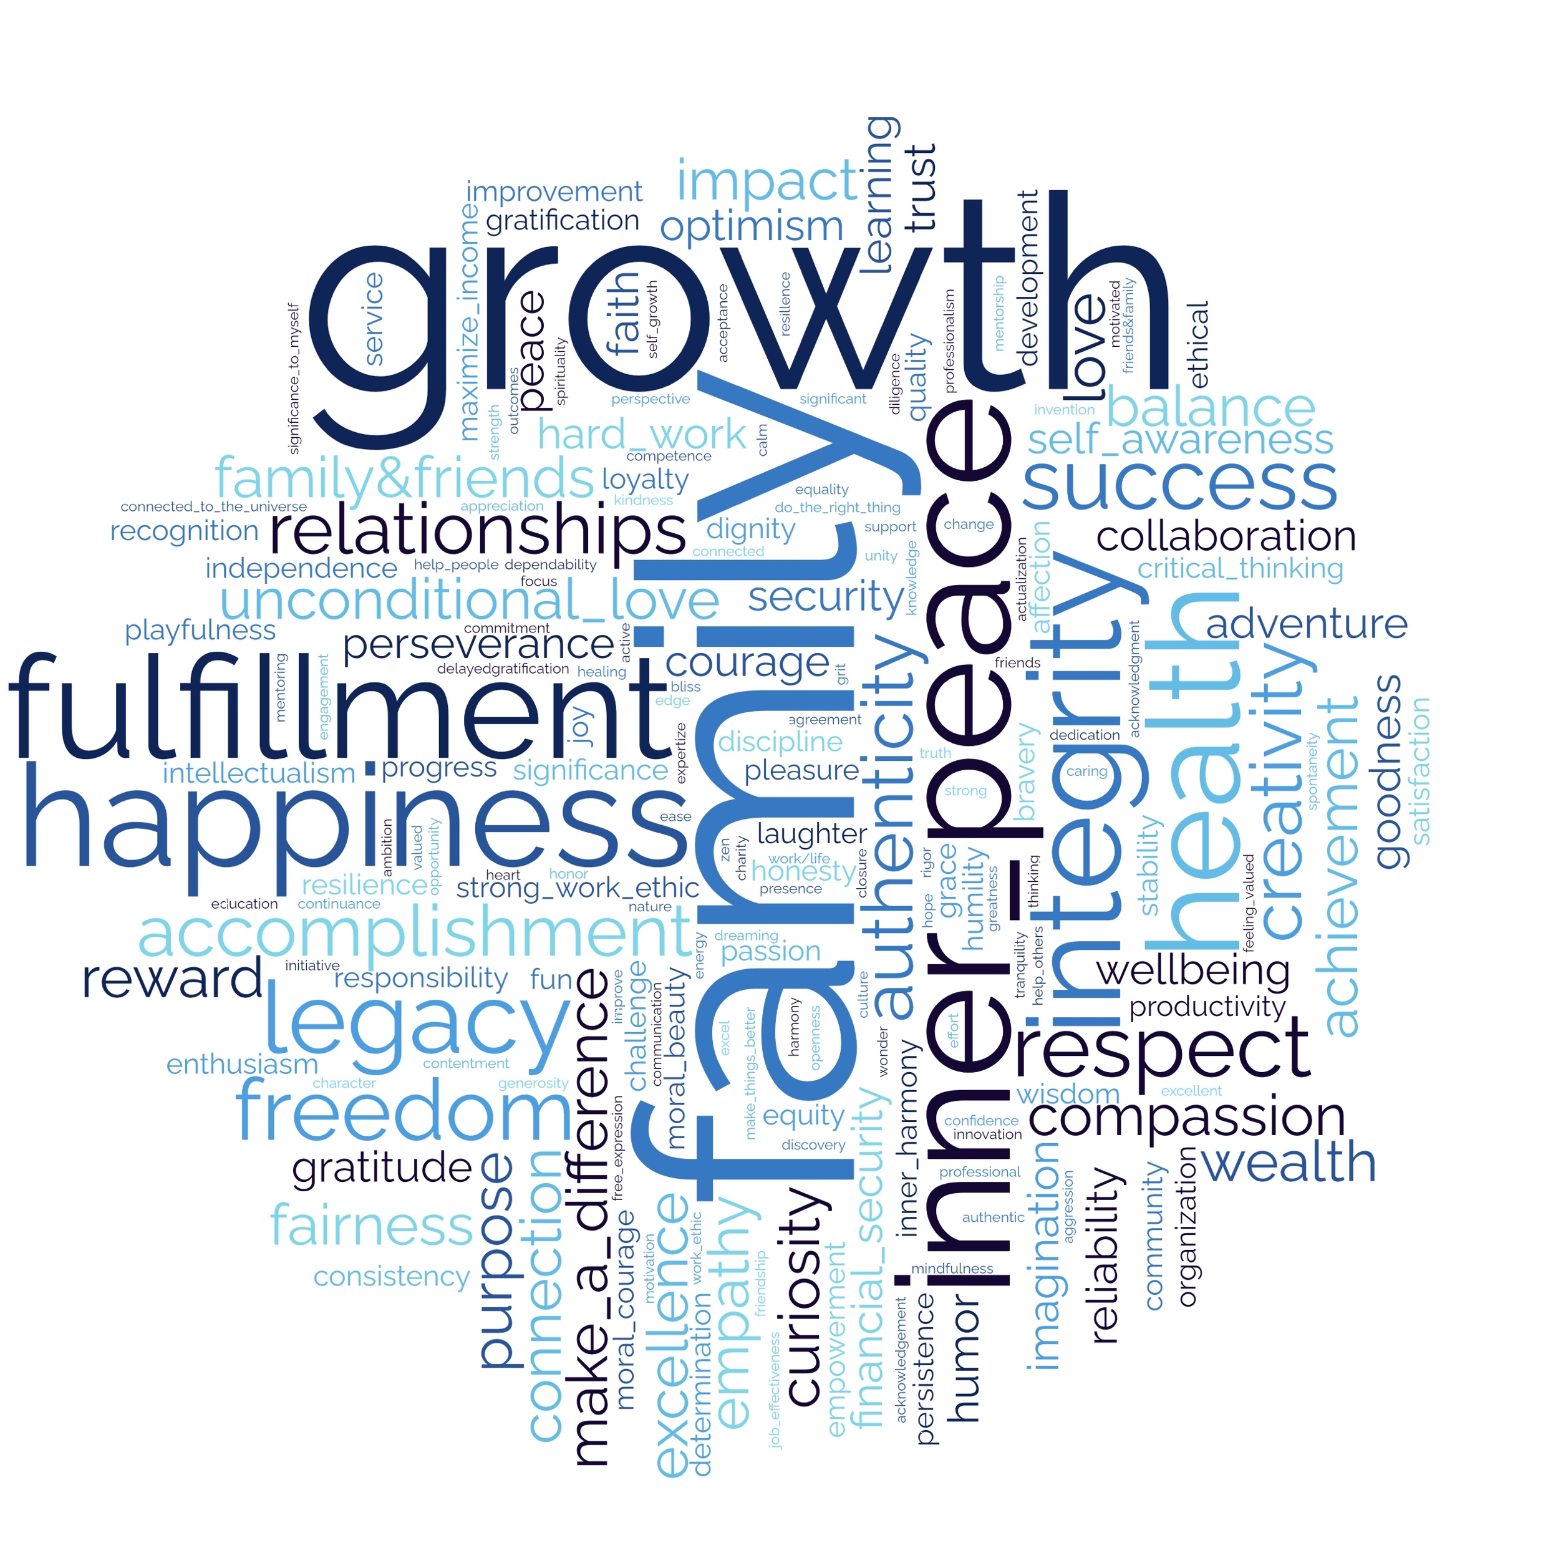

Slide 3
Jody Brauns
Relationships
Courage
Appreciation
Action
Mentorship
Regard
Gratitude
Learning

Slide 5
Iara Brudner Armele
Peace
Contentme
Confidence
Positivity
Kindness
Determinati
Trust
Honesty

Slide 7
Taylor Callaghan
Fun
Stong Work Ethic
Humility
Ambition
Passion
Survice
Integrity
Faith

Slide 9
Christian Cansino
Self-actualization
Help People
Feeling Alive
Empathy
Understanding
Impact
Recognition
Equity

Slide 11
Joy Chen
Success
Self-actualization
Competence
Achievement
Wealth
Persistence
Reward
Valued

Slide 13
Santiago Colorado Arias
Serentity
Outcomes
Transparency
Effort
Compassion
Listening
Humility
Duty

Slide 15
Benjamin Costa
Freedom
Wealth
Self-actualization & Growth
Persistence
Adapting
Mindfulness
Health
Family

Slide 17
Alessandro Creso
Legacy
Fulfilment
Uniqueness
Greatness
Diligence
Heart
Courage
Make A Difference
Valued

Slide 19
Theodore Davidson
Harmony
Improvement
Grace
Mentoring
Financial Security
Humor
Valued
Creativity

Slide 21
Elvins Derisma
Equanimity
Success
Valued
Progress
Generosity
Opportunity
Creativity
Adventure

Slide 23
Christopher Dionne
Fulfillment
Family
Freedom
Achievement
Reliability
Happiness
Deligence
Passion

Slide 25
Matthew Dripps
Peace
Stability
Legacy
Acknowledgement
Agency
Authenticity
Discovery
Industriousness

Slide 27
Tiina Drissen
Inner Harmony
Authenticity
Impact
Fun
Integrity
Growth
Loyalty
Empathy

Slide 29
Daniel Enriquez Rodriguez
Fulfillment
Purpose
Relationships
Knowledge
Resilience
Curiosity
Passion
Perseverance

Slide 31
Octavia Figueroa
Peace
Family + Relationships
Integrity
Growth
Giving
Stability
Mindfulness
Faith

Slide 33
Howard Font
Significance
Wisdom
Free Expression
Agency
Responsibility
Expertise
Awe
Grit

Slide 35
Jamie Fremgen
Inner Harmony
Love
Nature
Balance
Community
Exploration
Growth
Stability
Spirituality

Slide 37
Scott Gladstone
Grounded
Trust
Excel
Support
Mentoring
Expertise
Learning
Motivatio

Slide 39
Amin Gonzalez
Peace
Faith
Family
Make a difference
Courage
Fulfillment
Financial Security
Growth

Slide 41
Sahil Goswami
Preservance
Discipline
Wealth
Determination
Energy
Health
Work Ethic
Ambition

Slide 43
Charlotte Harrison
Fulfillment
Knowledge
Kindness
Ambition
Self- awareness
Make a difference
Purpose
Relationships

Slide 45
Lindsay Hylek
Freedom
Connection
Beauty
Innovation
Exuberance
Wealth
Accomplishment
Wonder

Slide 47
Di Jing
Well being
Growth
Relashionships
Adventure
Empowerment
Love
Family
Faith

Slide 49
David Kilybayev
Inner-harmony
Peace
Wellbeing
Kindness
Unconditional Love
Trust
Understanding
Empathy

Slide 51
Alexa Koike
Happiness
Growth
Purpose
Innovation
Achievement
Integrity
Reliability
Grace

Slide 53
Bo Lan
Fulfillment
Health
Family
Valued
Calm
Positivity
Achievement
Make A Difference

Slide 55
William Lazar
Fulfillment
Joy
Growth
Laughter
Teaching
Wisdom
Curiosity
Engaged

Slide 57
Kelvin Li
Inner peace
Tranquility
Mindfulness
Ease
Awe
Friendship
Progress
Competency

Slide 59
James Lindsey
Wonder
Freedom
Hope
Impact
Enthusiasm
Family
Learning
Integrity

Slide 61
Yucan Liu
Happiness
Respect
Family
Achievement
Health
Growth
Wealth
Energy

Slide 63
Joan Martinez
Inner peace
Impact
Family
Growth
Empathy
Intervention
Hard Work
Authenticity

Slide 65
Kevin McCahey
Peace
Dependability
Pride
Acknowledgement
Do the right thing
Autonomy
Loyalty
Empathy

Slide 66
Joan Martinez

Slide 67
Londyn Miller
Peace
Achievement
Altruism
Creativity
Actualization
Relationships
Impact
Spirituality

Slide 69
Molly Muench
Gratification
Connected to the Universe
Self-Esteem
Joy
Freedom
Fortitude
Beauty
Relationships

Slide 71
Farheen Mukarram
Connected to the Creator / Spirituality
Gratitude
Patience
Motivation
Family / Friends
Giving / Helping People
Fairness
Opportunity

Slide 73
Grace Muller
Peace of mind
Unconditional love
Maximize income
Friends & Family
Make things berrer
Achievement
Laughter
Respect

Slide 75
Akan Nelson
Connected to the Universe
Unconditional love
Family
Awareness
Self-actualization
Wisdom
Freedom
Innovation

Slide 77
Elyssa Ngai
Inner peace
Growth
Heart
Curiosity
Creativity
Authentivity
Grace
Faith

Slide 79
Rebecca Park
Love
Faith
Service
Caring
Responsibility
Engaged
Openness
Learning

Slide 81
Brittany Peyser
Happiness
Fulfillment
Growth
Family
Opportunity
Empowerment
Loyalty
Kindness

Slide 83
Zachary Pierce
Golden rule
Honesty
Generosity
Wisdom
Attention
Understanding
Discipline
Patience
Maximize income

Slide 85
Andrew Saba
Gratification
Achievement
Family
Critical thinking
Altruism
Industriousness
Positivity
Integrity
Adventure

Slide 87
Navi Saini
Well being
Family
Purpose
Loyalty
Impact
Independence
Greatness
Growth

Slide 89
Avantika Saisekar
Happiness
Love
Empowerment
Positivity
Impact
Growth
Grit
Wealth

Slide 91
Diptendra Sarkar
ZEN
Unity
Responsibility
Family
Ethical
Deligience
Optimism
Truth

Slide 93
Zara Sayeed
Fulfillment
Moral Courage
Commitment
Empathy
Inclusion
Accountably
Consistency
Compassion

Slide 95
Roger Seegolam
Inner peace
Independence
Positivity
Maximize income
Success
Love
Calm
Grit
Persistence
Honesty

Slide 97
Sumit Shukla
Safety
Family
Wealth
Health
Pleasure
Trust
Excellence
Duty

Slide 99
Mohit Soni
Inner peace
Balance
Freedom
Family
Wealth
Health
Excellence
Giving

Slide 101
Hassan Tariq
Peace
Relationships
Fulfillment
Presence
Courage
Legacy
Action
Excellence

Slide 103
Maisha Tasnim
Integrity
Family & Friends
Success
Faith & Mindfulness
Growth
Enthusiasm
Courage
Freedom

Slide 105
Vincent Tasso
Contentment
Impact
Work Life Harmony
Connection
Preseverance
Teamwork
Work Ethic
Honesty

Slide 107
Tony Tchoualack
Goodness
Greatness
Mindfulness
Inclusion
Balance
Confidence
Gratitude
Critical thinking

Slide 109
Jyoti Vagare
Happiness
Family
Growth
Gratitude
Respect
Effort
Actualizetion
Integrity

Slide 111
Justin Weatherby
Serenity
Impact
Adventure
Service
Dignity
Imagination
Logic
Uniqueness

Slide 113
Cutler Whitely
Integrity
(Holistic / Visionary)
Thinking
Gratification
Rigor
Imagination
Empowerment
Justice
Openness

Slide 115
Tao Zhang
Freedom
Friends and Family
Faith
Love
Trust
Happiness
Dreaming
Motivation

Slide 117
Ramell Ridenhour
Peace
Loyalty
Other Focused
Consistency
Mentoring
Listening
Optimism
Critical thinking

Slide 119
Brandon Gaynor
Fulfillment
Family
Compassion
Adventure
Stability
Growth
Wealth
Challenge

Slide 121
Stephanie Vyas
Inner harmony
Wealth
Improvement
Accompolishment
Confidence
Spontaneity
Relationships
Validation

Slide 123
Cameron Eskandari
Stength
Bliss
Beauty
Honor
Wisdom
Congeniality
Pleasure
Dreaming

Slide 125
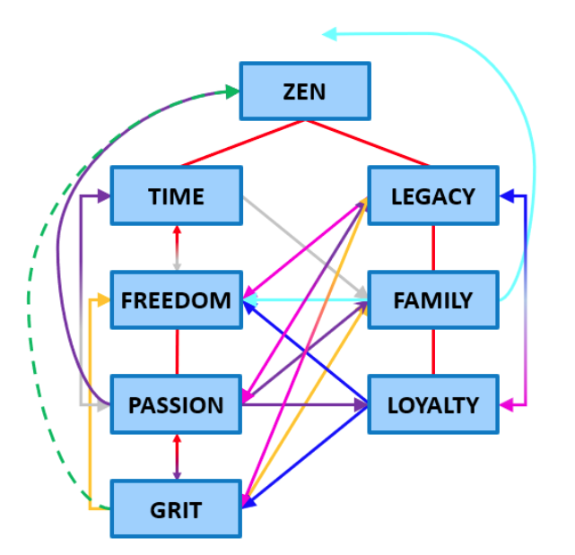
John Swierkocki

